Slide 1
Electric Vehicle (EV) Adoption Analysis in Washington State
Geographic Distribution, and Market Penetration Analysis
Presented By,
Kareemulla Adivigalla
Data Analyst

Slide 2
Executive Summary
The project aimed to analyze EV adoption across Washington State.
This project aims to analyze the geographic distribution, and market penetration related to electric vehicles (EVs) in Washington state. By examining data on EV adoption across various counties and cities, the project provides insights that can guide policy decisions, marketing strategies, and support programs for electric vehicles.

Slide 3
Business Objectives
1. Geographic Distribution Analysis
Objective: Identify which counties and cities in Washington state have the highest and lowest numbers of electric vehicles (EVs).
Goal: Understand regional adoption trends and identify areas that may benefit from additional support or incentives to encourage higher adoption of EVs.
2. Market Penetration and Growth Trends
Objective: Analyze how the number of electric vehicles has changed over time across different counties and cities.
Goal: Understand the growth trend of EV adoption and project future adoption rates to help stakeholders plan accordingly.

Slide 4
Data Overview
Source: The dataset was sourced from publicly available EV registration data in Washington State. i.e., Data.gov website.

Slide 5
Data Overview
Columns Included:
VIN (1-10): Vehicle Identification Number.
County, City, State, Postal Code: Geographic information.
Model Year: Year the EV model was manufactured.
Make, Model: Manufacturer and model of the EV.
Electric Vehicle Type: BEV or PHEV.
CAFV Eligibility: Whether the vehicle is eligible for Clean Alternative Fuel Vehicle incentives.
Electric Range: Maximum range of the vehicle on a single charge.
Base MSRP: Manufacturer's Suggested Retail Price.
Electric Utility, 2020 Census Tract: Additional geographic and utility data.
Derived Features: Features engineered during the preprocessing phase, such as 'Vehicle Age', 'Make_Proportion', 'Dominant_Manufacturer_Proportion', etc.

Slide 6
Data Overview
Preprocessing Steps:
Data Cleaning:
Handling Missing Values: Imputation or removal of missing data points to ensure completeness.
Outlier Removal: Removed extreme values in MSRP and Electric Range to avoid skewed results.
Saved the cleaned dataset for EDA

Slide 7
Exploratory Data Analysis (EDA)
Purpose of EDA:
To understand the structure, patterns, and key characteristics of the dataset.
To identify relationships, trends, and anomalies that could influence the outcomes of the analysis.

Slide 8
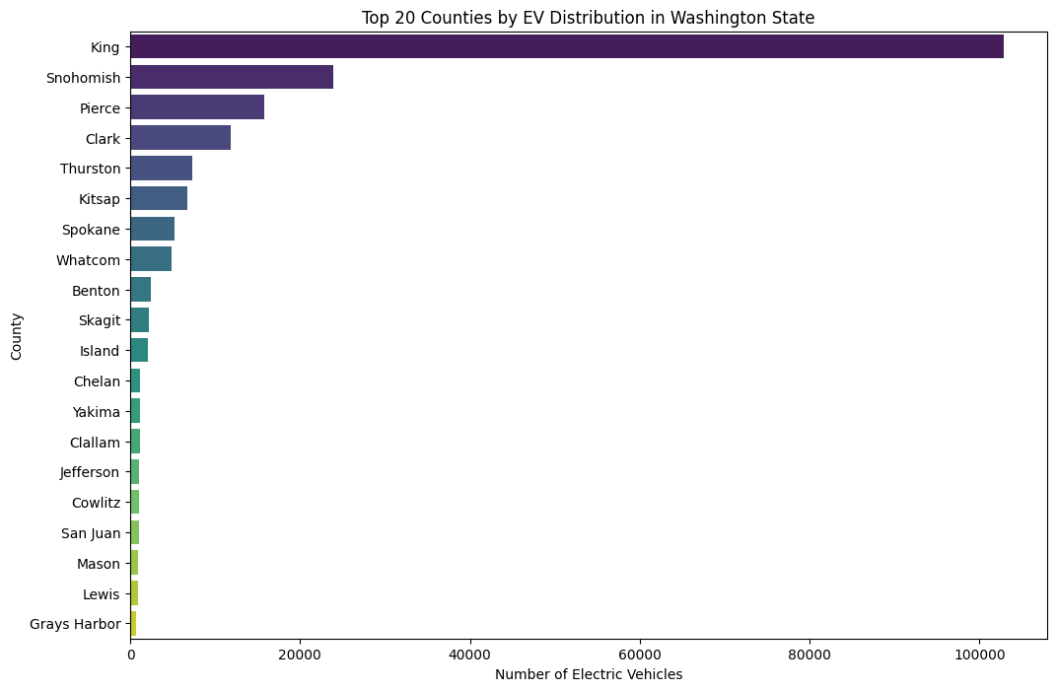
Top 20 Cities by EV Distribution in Washington State

Slide 9
Key findings
King County has the highest number of electric vehicles, far surpassing other counties.
Snohomish and Pierce Counties also have a significant number of electric vehicles, but much less compared to King County.
The distribution drops off quickly after the top few counties, with the remaining counties in the top 20 having relatively fewer electric vehicles.
This suggests that electric vehicle adoption is heavily concentrated in a few key counties, particularly in urban areas.

Slide 10
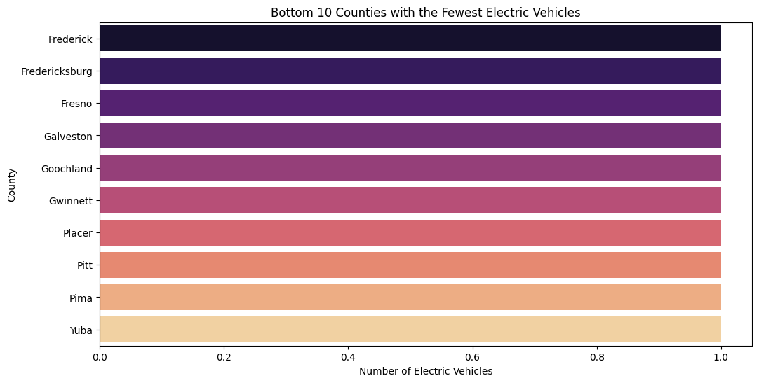
Bottom 10 Counties with the Fewest Electric Vehicles

Slide 11
Key findings
These bottom 10 counties have the fewest electric vehicles, each with a very low count, nearly identical across the counties.
This indicates extremely low adoption of electric vehicles in these regions.
The uniformity in low numbers suggests that these counties might lack the infrastructure, incentives, or awareness needed to drive higher adoption rates.

Slide 12
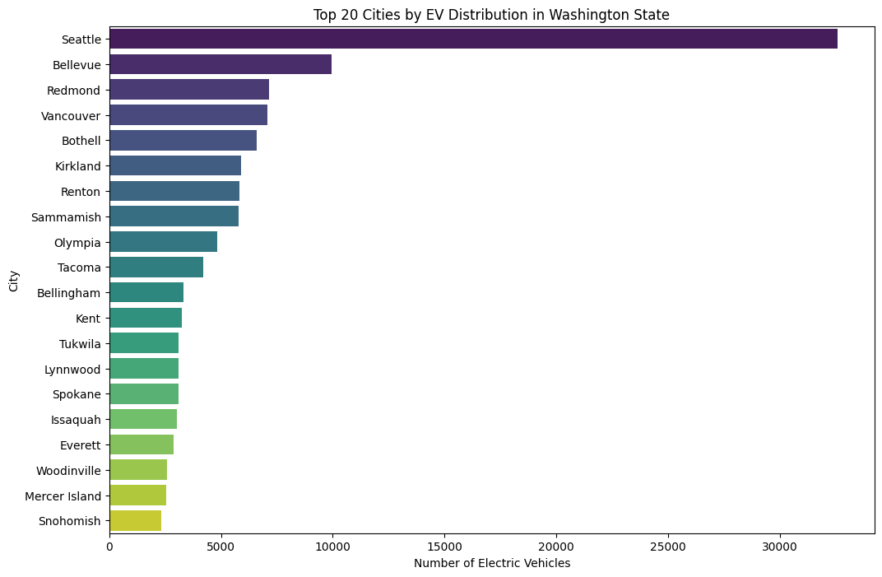
Top 20 Cities by EV Distribution in Washington State

Slide 13
Key findings
Seattle has the highest number of electric vehicles among all cities in Washington State, significantly outpacing other cities.
Bellevue and Redmond also have high numbers of electric vehicles, reflecting strong adoption in these cities.
The distribution shows that electric vehicle adoption is concentrated in larger, more affluent cities, with the top cities leading by a considerable margin.
Smaller cities like Snohomish and Mercer Island are in the top 20 but have noticeably fewer electric vehicles compared to the leading cities.

Slide 14
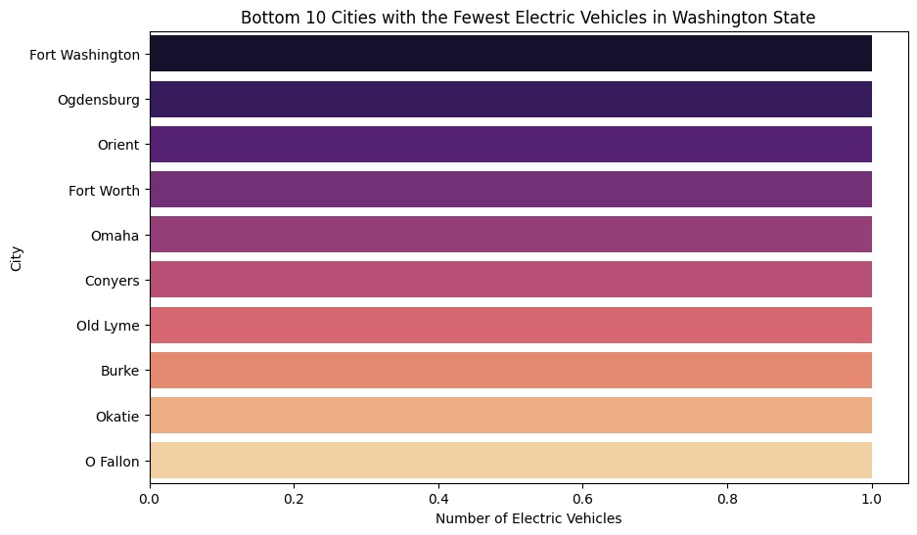
Bottom 10 Cities with the Fewest Electric Vehicles in Washington State

Slide 15
Key findings
These bottom 10 cities (Fort Washington, Ogdensburg, orient, Fort Worth, Omaha etc.,) have the fewest electric vehicles, with very similar and extremely low counts.
This indicates that electric vehicle adoption is nearly nonexistent in these cities.
The uniformity in low numbers suggests that these cities might face common barriers to adoption, such as limited infrastructure, lack of incentives, or lower public awareness.

Slide 16
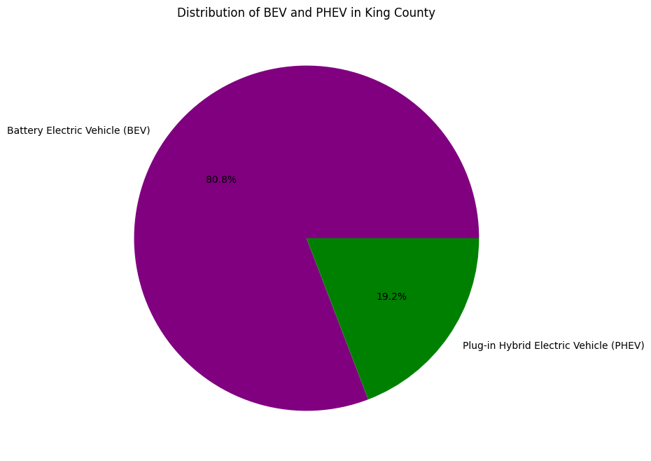
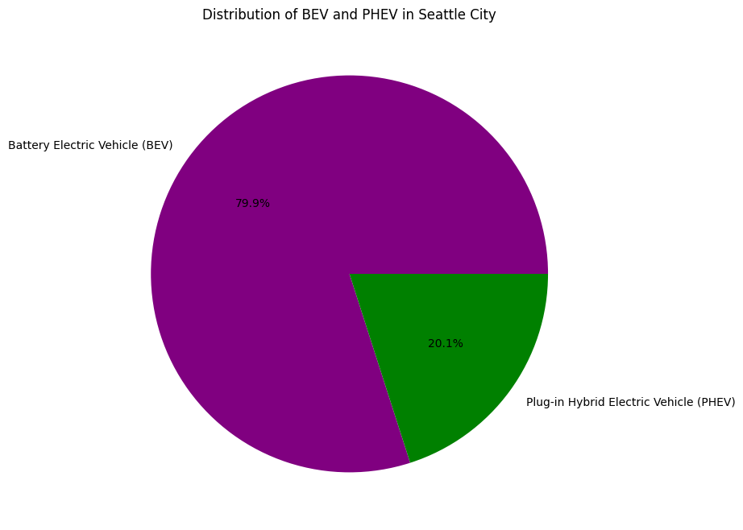
Distribution of BEV and PHEV in KING County & Seattle city

Slide 17
KEY FINDINGS
In King County, Battery Electric Vehicles (BEVs) make up the majority, accounting for 80.8% of the electric vehicles.
Plug-in Hybrid Electric Vehicles (PHEVs) represent 19.2% of the electric vehicles in the county.
This indicates a strong preference for fully electric vehicles (BEVs) over hybrids (PHEVs) among consumers in King County.
In Seattle City, Battery Electric Vehicles (BEVs) constitute the majority, making up 79.9% of the electric vehicles.
Plug-in Hybrid Electric Vehicles (PHEVs) account for 20.1% of the electric vehicles in the city.
This shows a strong preference for fully electric vehicles (BEVs) over hybrids (PHEVs) among Seattle residents, similar to the trend observed in King County.

Slide 18
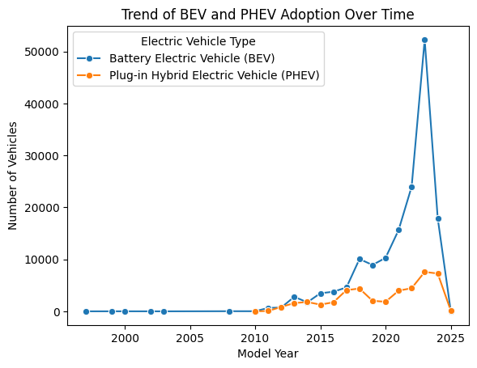
Trend of BEV and PHEV Adoption Over Time

Slide 19
Key Findings
Battery Electric Vehicles (BEVs) have seen a significant and sharp increase in adoption since around 2015, peaking around 2021.
Plug-in Hybrid Electric Vehicles (PHEVs) have also grown in popularity, but at a much slower rate compared to BEVs.
The trend shows a clear preference for BEVs over time, especially in recent years, indicating that fully electric vehicles are becoming more popular.

Slide 20
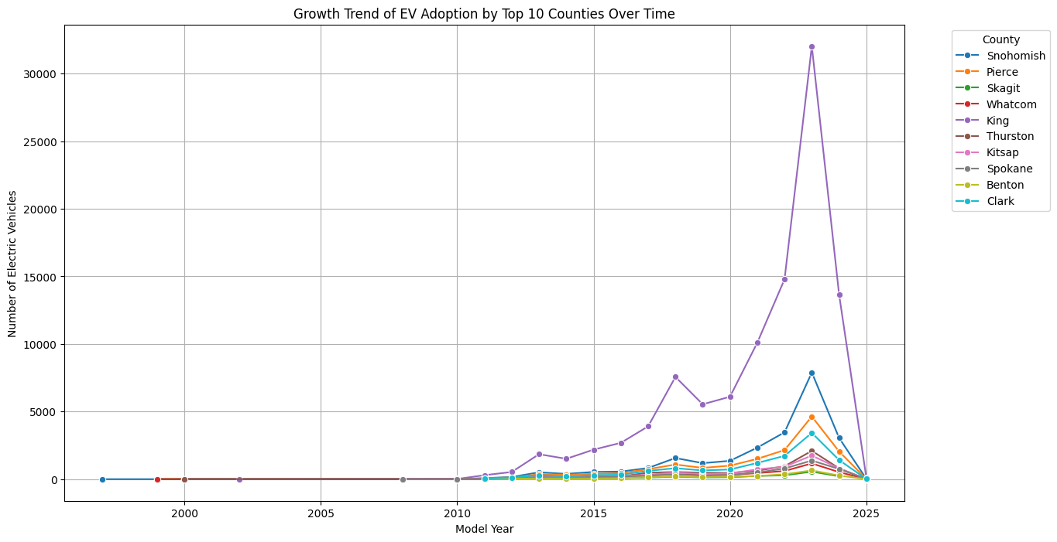
Growth Trend of EV Adoption by Top 10 Counties Over Time

Slide 21
Key findings
King County has had a significant increase in electric vehicle adoption, peaking around 2021, far outpacing other counties.
Snohomish, Pierce, and Clark Counties also show growth in EV adoption but at much lower levels compared to King County.
Most other counties have seen steady but smaller increases in EV adoption over time.
The trend indicates that King County is the primary driver of EV growth in Washington State, with other counties following but at a slower pace.

Slide 22
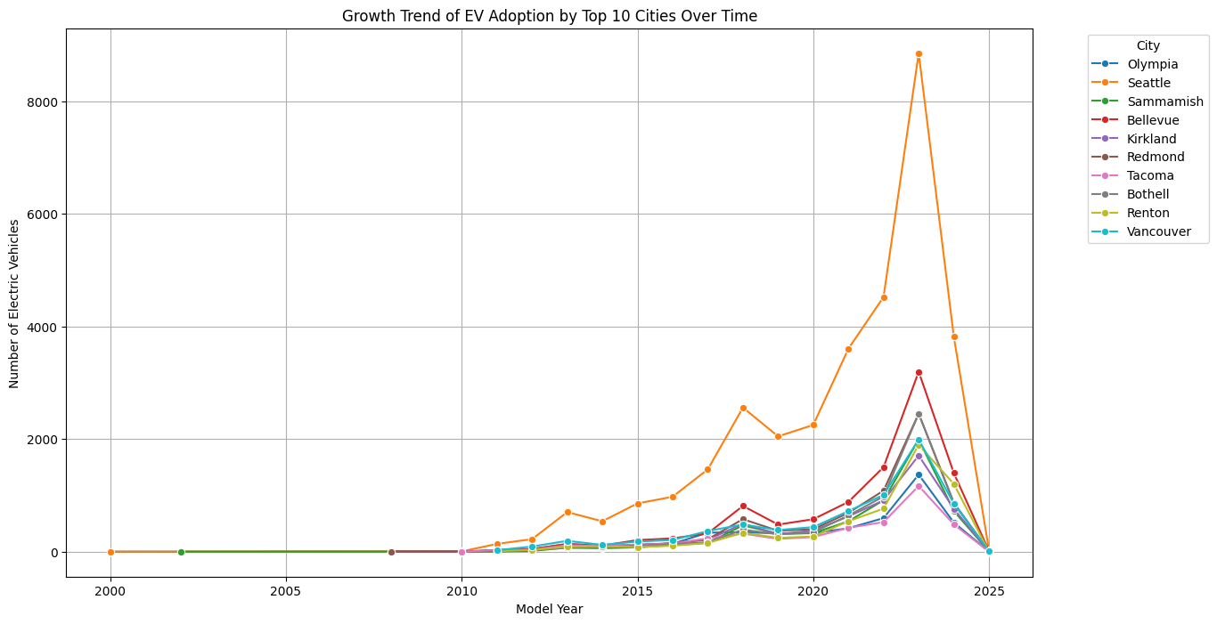
Growth Trend of EV Adoption by Top 10 Cities Over Time

Slide 23
KEY FINDINGS
Seattle has experienced the most significant growth in electric vehicle adoption among the top 10 cities, peaking around 2021.
Other cities like Bellevue, Redmond, and Tacoma also show growth, but at lower levels compared to Seattle.
Most cities saw a rise in EV adoption starting around 2015, with a noticeable peak around 2020-2021.
The trends indicate that while Seattle leads in EV adoption, other cities are following a similar upward trend, though at a smaller scale.

Slide 24
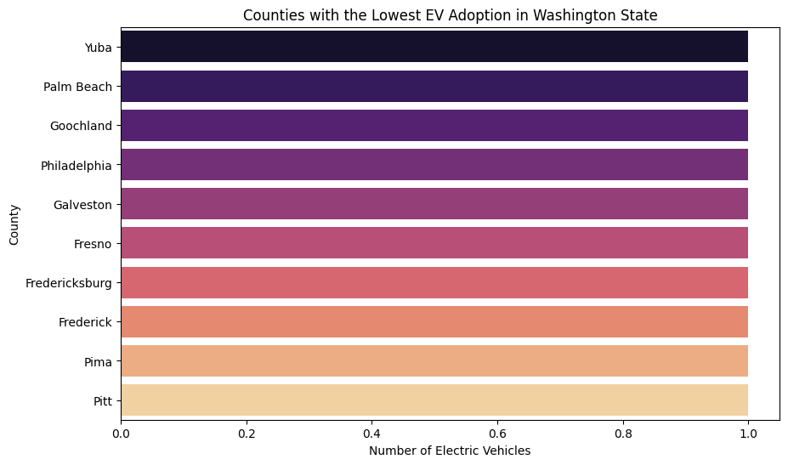
Counties with the Lowest EV Adoption in Washington State

Slide 25
KEY FINDINGS
Yuba, Palm Beach, Goochland, Philadelphia, Galveston, Fresno, Fredericksburg, Frederick, Pima, and Pitt are the counties with the lowest number of electric vehicles in Washington State.
The adoption rates are very low and nearly identical across these counties.
This indicates that electric vehicle adoption is minimal in these areas, suggesting potential barriers like lack of infrastructure, incentives, or awareness.

Slide 26
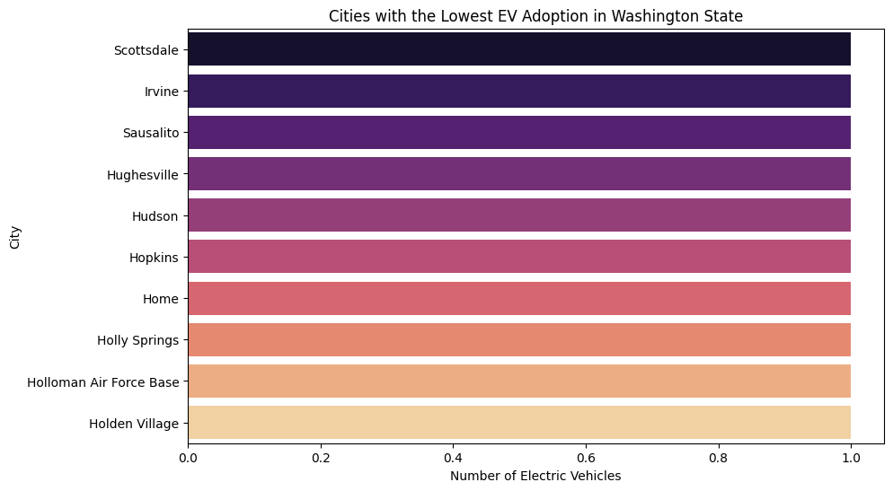
Cities with the Lowest EV Adoption in Washington State

Slide 27
KEY FINDINGS
Scottsdale, Irvine, Sausalito, Hughesville, Hudson, Hopkins, Home, Holly Springs, Holloman Air Force Base, and Holden Village are the cities with the lowest number of electric vehicles in Washington State.
The adoption of electric vehicles in these cities is very minimal and nearly identical.
These areas may face challenges like limited access to charging infrastructure, fewer incentives, or less awareness of electric vehicles.

Slide 28
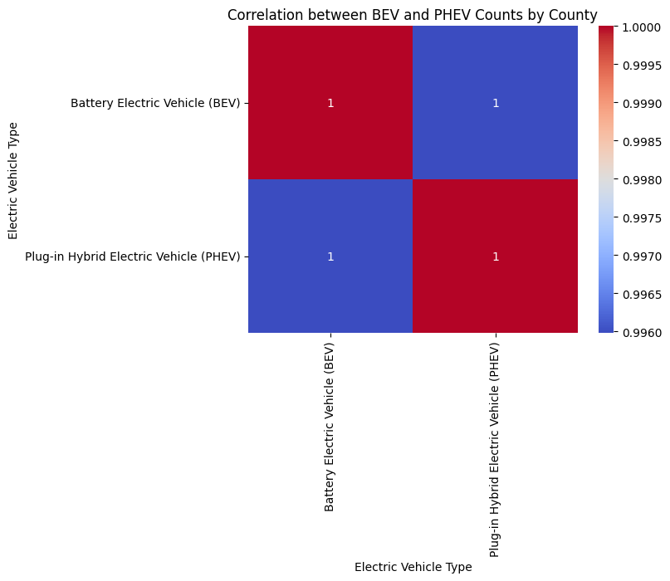
Correlation Between BEVs and PHEVs

Slide 29
KEY FINDINGS
The correlation heatmap shows that there is a perfect correlation (correlation coefficient of 1) between the counts of Battery Electric Vehicles (BEVs) and Plug-in Hybrid Electric Vehicles (PHEVs) across counties.
This suggests that counties with high BEV adoption also tend to have high PHEV adoption, and vice versa. The relationship between the two types of electric vehicles is very strong and consistent across different counties.

Slide 30
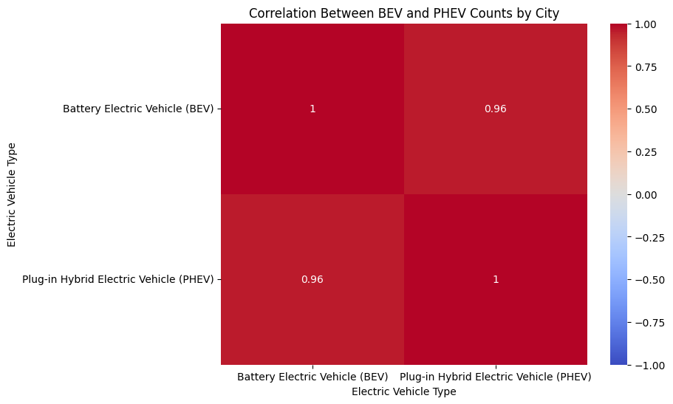
Correlation Between BEV and PHEV Counts by City

Slide 31
KEY FINDINGS
The correlation heatmap shows a very strong positive correlation (0.96) between the counts of Battery Electric Vehicles (BEVs) and Plug-in Hybrid Electric Vehicles (PHEVs) across cities.
This indicates that in cities where there is a high adoption of BEVs, there is also likely to be a high adoption of PHEVs, and vice versa. The relationship is slightly less perfect than at the county level, but it still shows a strong alignment in the adoption patterns of these two types of electric vehicles within cities.

Slide 32
1> Insights on EDA
King County leads EV adoption with over 100,000 electric vehicles (EVs), making up over 50% of all EVs in Washington State. This includes around 80,800 Battery Electric Vehicles (BEVs) and 19,200 Plug-in Hybrid Electric Vehicles (PHEVs).
Snohomish County follows King County with about 25,000 EVs, and Pierce County has around 20,000 EVs. Both counties have a high concentration of BEVs, with Snohomish having around 19,000 BEVs and Pierce around 15,000 BEVs. Cities with the highest EV adoption rates include Seattle (approximately 35,000 EVs), Bellevue (15,000 EVs), and Redmond (12,000 EVs).
The bottom 10 counties, including Yuba, Palm Beach, and Goochland, have extremely low EV adoption rates, each with less than 10 EVs in total, split almost equally between BEVs and PHEVs.
Seattle has the highest number of EVs in any city, with 79.9% BEVs and 20.1% PHEVs. This indicates a strong preference for fully electric vehicles in the city.
In cities like Bellevue and Redmond, EVs are predominantly BEVs. Bellevue has around 12,000 BEVs and 3,000 PHEVs. This trend reflects the higher adoption rates in tech-driven and affluent cities.
Cities like Scottsdale, Irvine, and Sausalito have the lowest EV adoption rates, each with less than 10 EVs. This suggests minimal adoption in these areas, possibly due to limited infrastructure or lower public awareness.

Slide 33
2> Insights on EDA
Tacoma and Everett each have around 5,000 EVs, with a balanced mix of BEVs and PHEVs. These cities are poised for growth with further infrastructure investments.
BEVs are more common than PHEVs across most counties. King County alone has over 80,000 BEVs compared to around 19,000 PHEVs. This preference for BEVs is also reflected in cities like Seattle and Bellevue.
There is a strong positive correlation (close to 1) between BEV and PHEV adoption across counties and cities. This means that regions with high BEV adoption also tend to have high PHEV adoption.
The highest growth in EV adoption was observed in 2021, with over 50,000 BEVs and around 7,000 PHEVs registered that year. However, there was a noticeable decline in 2022, with fewer new registrations.
The lowest adoption years for EVs were before 2010, where both BEVs and PHEVs had fewer than 1,000 registrations per year.

Slide 34
Recommendations ON EDA
Continuing supporting King County’s EV infrastructure to maintain its 100,000+ EVs and use it as a model to replicate success in Snohomish and Pierce Counties, which already have 25,000 and 20,000 EVs respectively.
Focusing on expanding infrastructure in high-adoption counties like Snohomish (19,000 BEVs) and Pierce (15,000 BEVs) to continue their growth.
Implementing targeted incentives and enhance infrastructure in counties like Yuba and Palm Beach where EV numbers are still below 10.
Using Seattle’s success with 35,000 EVs to benchmark and spread best practices to nearby cities like Tacoma and Everett, which have 5,000 and 4,500 EVs respectively.
Continuing expanding the charging network in cities like Bellevue (15,000 EVs) and Redmond (12,000 EVs) to sustain their growth.
Investing in cities like Tacoma and Everett to accelerate their adoption, potentially raising their 5,000 and 4,500 EV counts closer to that of the top cities.
Giving the dominance of BEVs, with 80,800 BEVs in King County alone, focus on building more fast-charging stations to cater to the growing BEV population.
Leveraged the strong correlation between BEV and PHEV adoption by ensuring infrastructure investments support both types, thereby maximizing overall EV adoption.
Analyzing the causes behind the decline in registrations post-2021, particularly focusing on factors that caused BEV registrations to drop from 50,000 in 2021 to 30,000 in 2022.
Increasing charging infrastructure availability, enhance incentives, and conduct awareness campaigns in low-adoption cities like Scottsdale, Irvine, and Sausalito, where EV counts are under 10.

Slide 35
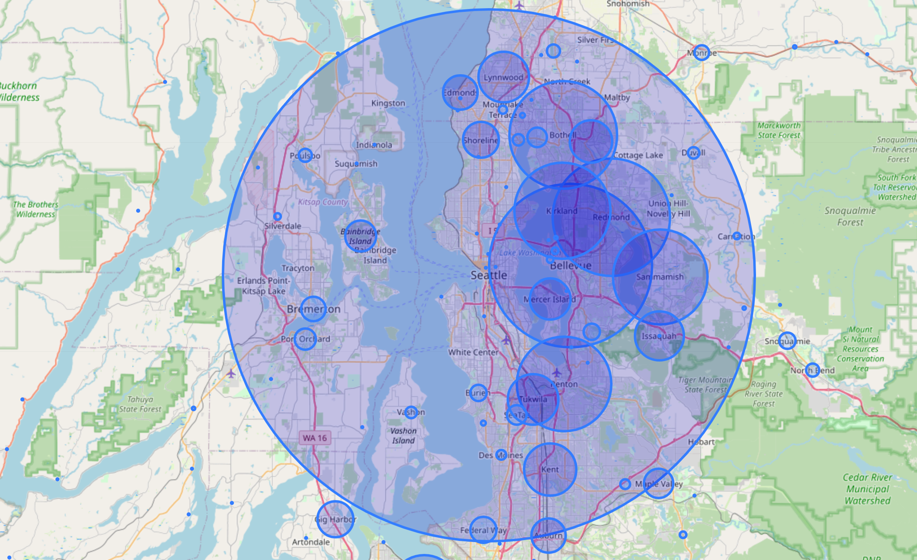
Geographic Distribution of EVs

Slide 36
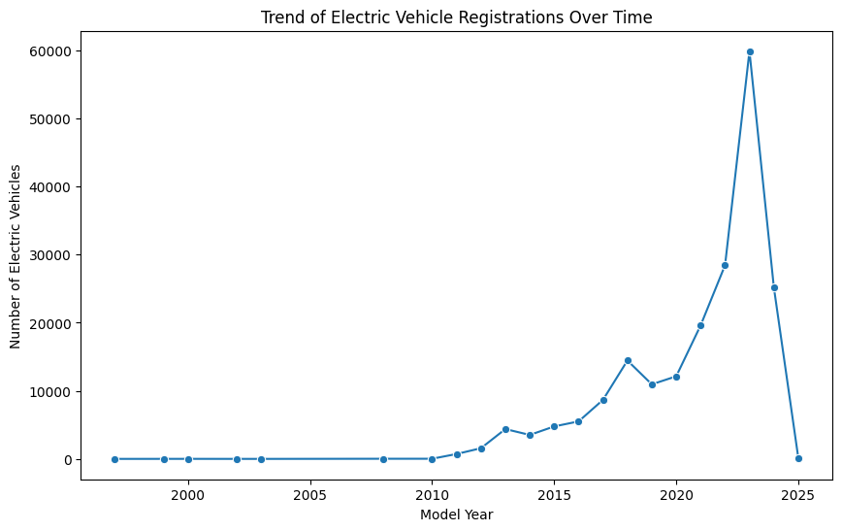
Trend of Electric Vehicle Registrations Over Time

Slide 37
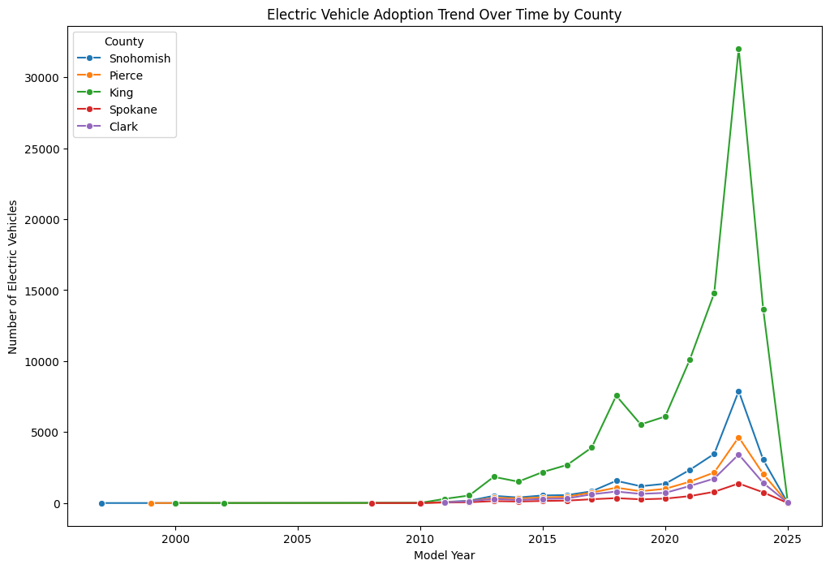
Electric Vehicle Adoption Trend Over Time by County

Slide 38
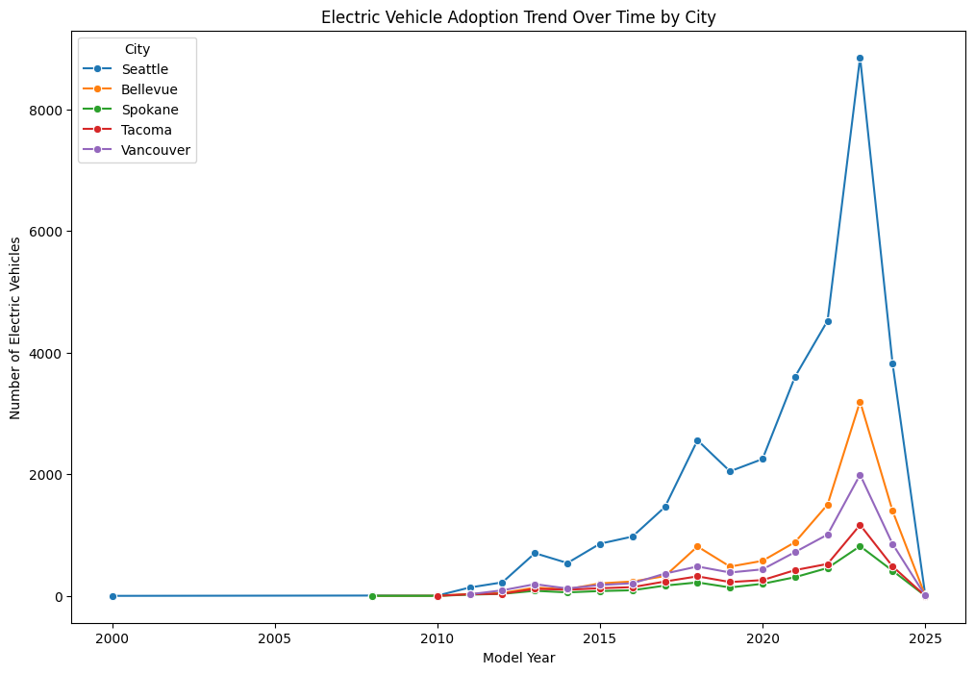
Electric Vehicle Adoption Trend Over Time by City

Slide 39
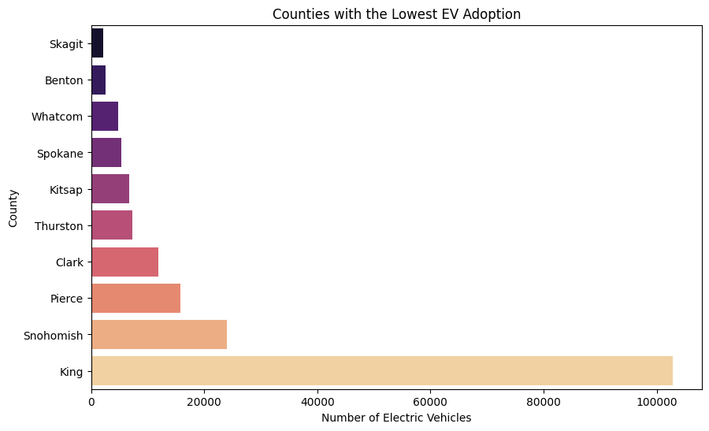
Counties with the Lowest EV Adoption

Slide 40
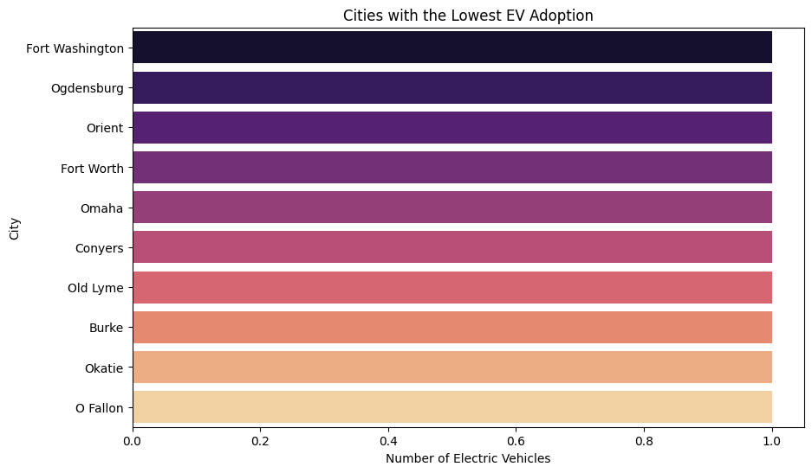
Cities with the Lowest EV Adoption

Slide 41
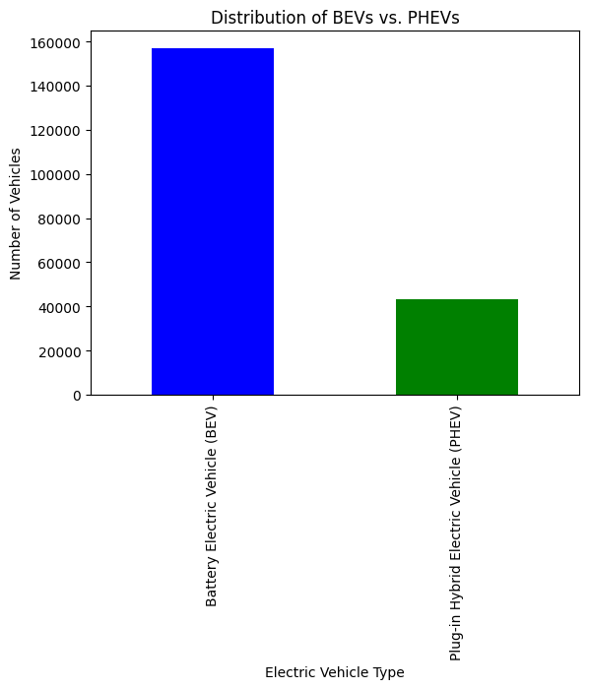
Distribution of BEVs vs. PHEVs

Slide 42
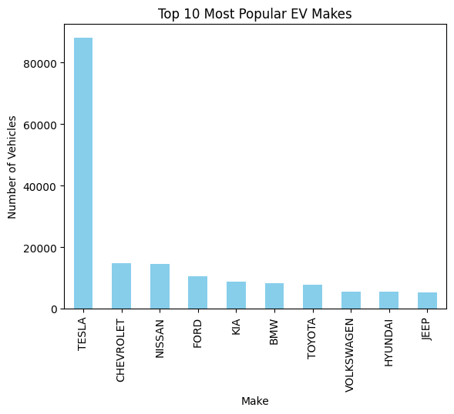
Top 10 Most Popular EV MakeRs

Slide 43
KEY FINDINGS
Tesla is by far the most popular EV make, with over 80,000 vehicles registered, significantly outpacing all other manufacturers. This shows Tesla's strong market presence in the EV sector.
Chevrolet and Nissan follow, but with a much lower number of vehicles compared to Tesla, each having around 10,000 to 15,000 vehicles.
The remaining brands like Ford, Kia, BMW, Toyota, and Volkswagen have smaller but still notable shares in the EV market. Their numbers range from around 5,000 to 10,000 vehicles.
Hyundai and Jeep make up the bottom of the top 10, indicating that they are less popular EV choices among consumers compared to other brands.

Slide 44
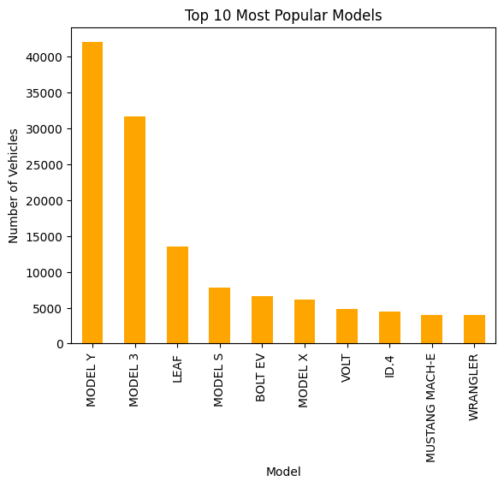
TOP 10 MOST POPULAR MODELS

Slide 45
Top 10 Most Popular Models
Tesla's Model Y is the most popular model, with over 40,000 vehicles, followed by the Model 3 with over 30,000 vehicles. These two models dominate the EV market, highlighting Tesla's strong presence.
The Nissan Leaf is the third most popular model, with a noticeable drop in numbers compared to Tesla models, around 15,000 vehicles.
The Tesla Model S and Model X are also in the top 10, though with fewer registrations compared to the Model Y and Model 3, showing that Tesla's other offerings are also popular, albeit to a lesser extent.
The Chevrolet Bolt EV, Chevrolet Volt, Volkswagen ID.4, Ford Mustang Mach-E, and Jeep Wrangler round out the top 10, each with a few thousand vehicles. These models represent a mix of traditional automakers entering the EV market.

Slide 46
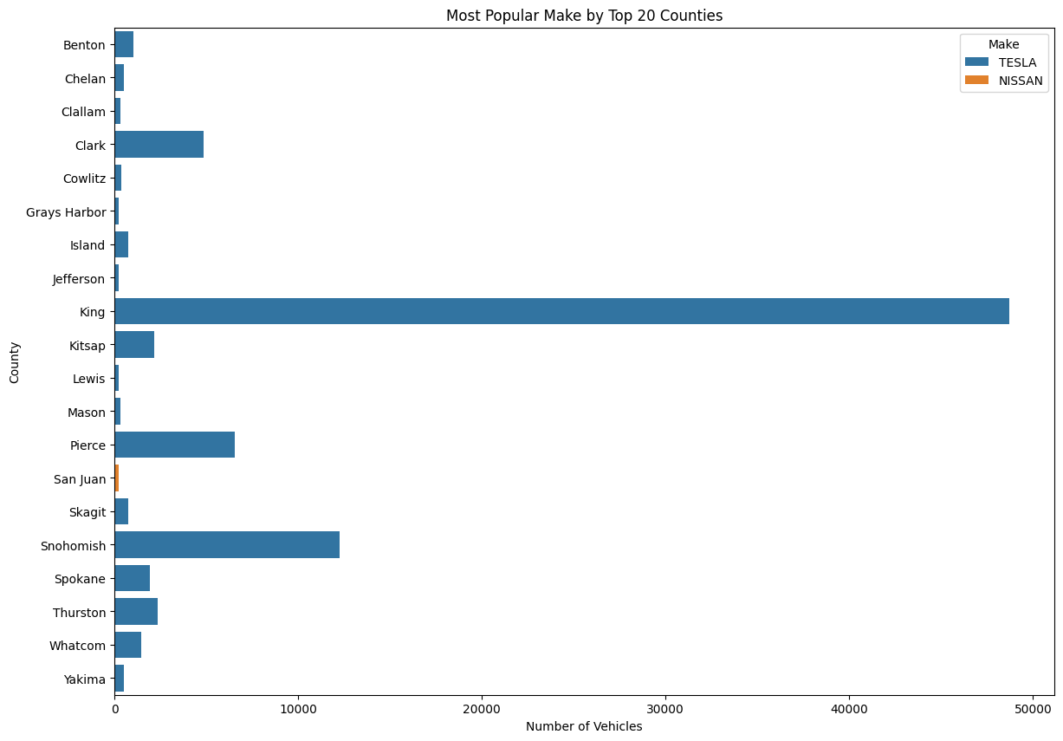
Most Popular Make by Top 20 Counties

Slide 47
KEY FINDINGS
Tesla is the most popular EV make in almost all of the top 20 counties, with King County having an exceptionally high number of Tesla vehicles compared to other counties. This reaffirms Tesla's strong market presence in Washington State.
King County alone has more Tesla vehicles than any other county, reflecting its status as a major hub for EV adoption. The number of Teslas in King County significantly overshadows the numbers in other counties.
Snohomish and Pierce Counties also show a considerable number of Tesla vehicles, though still much lower than King County. Clark County follows with a moderate number of Teslas.
Nissan appears as the most popular make in San Juan County, but its presence is minimal compared to Tesla's dominance across the other counties.

Slide 48
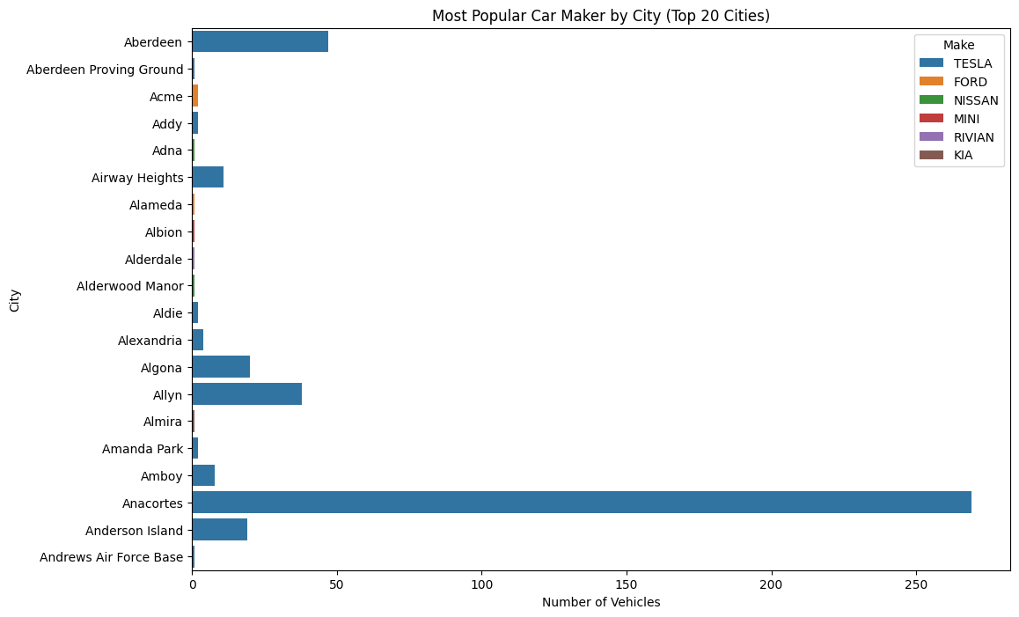
Most Popular Car Maker by City (Top 20 Cities)

Slide 49
KEY FINDINGS
Tesla is overwhelmingly the most popular EV make in most of the top 20 cities, particularly in cities like Anacortes, Allyn, and Algona. This consistent dominance underscores Tesla's market strength across various cities.
The number of Tesla vehicles is notably high in Anacortes, where it far exceeds the number of Tesla vehicles in other cities. Allyn and Aberdeen also show a significant number of Teslas, though still much less compared to Anacortes.
Other car makers like Ford, Nissan, MINI, and Rivian appear in a few cities but with much lower counts compared to Tesla. For example, Ford shows up in Acme, and Nissan in Alderwood Manor, but their presence is minimal.
In some cities, a single EV make like Tesla completely dominates the market, while in others, there is at least some presence of alternative makes, though still dwarfed by Tesla.

Slide 50
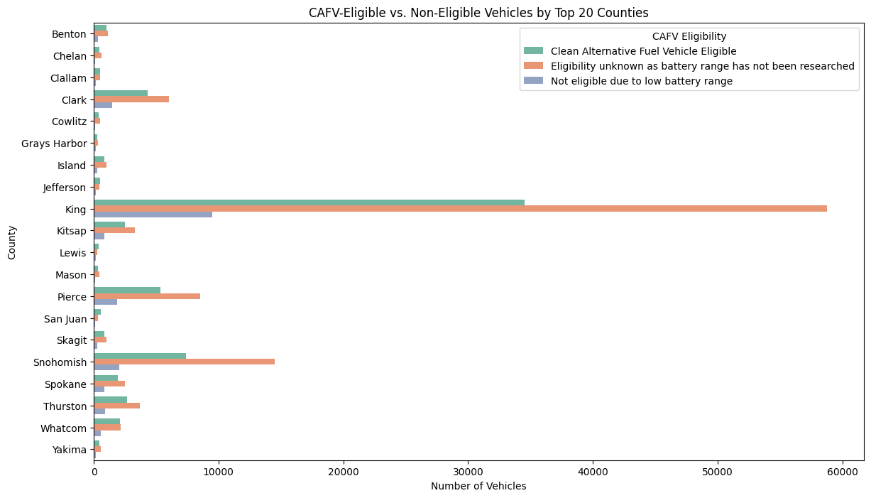
CAFV-Eligible vs. Non-Eligible Vehicles by Top 20 Counties

Slide 51
KEY FINDINGS
King County has the highest number of CAFV-eligible vehicles by a significant margin, indicating that a large portion of its electric vehicle fleet meets the criteria for clean alternative fuel vehicles.
However, King County also has a considerable number of vehicles where eligibility is unknown, suggesting that further research or data collection may be needed to fully understand the CAFV potential in this county.
Counties such as Snohomish, Pierce, and Clark also show a reasonable number of CAFV-eligible vehicles, reflecting their urban nature and more extensive EV adoption.
These counties also have a significant number of vehicles where eligibility is unknown, which might indicate a similar need for more detailed data.
Rural counties like Grays Harbor, Island, and Clallam have much lower numbers of CAFV-eligible vehicles, which is consistent with the overall lower adoption of EVs in these areas.
The presence of non-eligible vehicles due to low battery range is also more noticeable in these counties, likely reflecting the older or less advanced EVs that may be more prevalent in rural areas.
Across several counties, there is a significant proportion of vehicles where CAFV eligibility is unknown, mainly due to the lack of information on battery range.

Slide 52
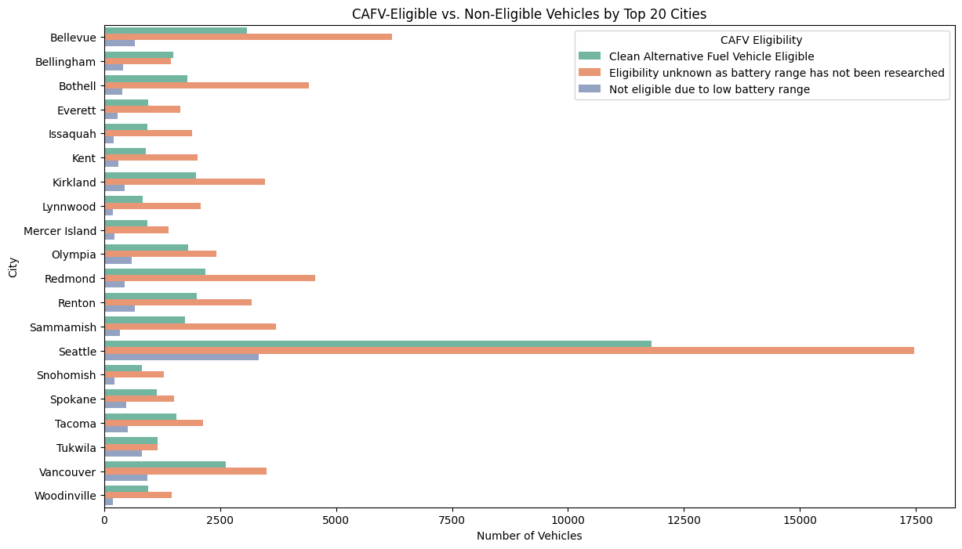
CAFV-Eligible vs. Non-Eligible Vehicles by Top 20 Cities

Slide 53
KEY FINDINGS
Seattle has the highest number of CAFV-eligible vehicles, which aligns with its overall leadership in EV adoption. However, Seattle also has a large number of vehicles where eligibility is unknown, indicating a need for further investigation to determine the full potential for CAFV.
Across most cities, there is a notable portion of vehicles where the eligibility is unknown due to the lack of data on battery range. This is especially prominent in cities like Bellevue, Bothell, and Sammamish. Addressing this data gap could provide clearer insights into the potential for CAFV expansion.
Cities such as Bellevue, Redmond, and Kirkland show a moderate number of CAFV-eligible vehicles, reflecting their suburban nature and significant EV adoption rates. These cities also have a considerable number of vehicles with unknown eligibility, similar to the trend observed in Seattle.
Smaller cities like Tukwila, Woodinville, and Mercer Island have fewer CAFV-eligible vehicles. The lower overall EV adoption in these areas likely contributes to this trend.

Slide 54
Hypothesis Testing
Hypothesis 1: Urbanization and BEV Adoption
Null Hypothesis (H0): There is no significant difference in the proportion of BEVs compared to PHEVs between urban and non-urban areas.
Alternative Hypothesis (H1): Urban areas have a significantly higher proportion of BEVs compared to PHEVs than non-urban areas.

Slide 55
Interpretation of Results
Chi-square Statistic: 744.60 The chi-square statistic of 744.60 is very large, indicating a substantial difference between the observed and expected frequencies in the contingency table. This suggests a strong association between the type of area (urban vs. non-urban) and the adoption of Battery Electric Vehicles (BEVs).
P-Value: 6.00e-164 The p-value of 6.00e-164 is extremely small, far below any common significance level (e.g., 0.05). This indicates that the likelihood of observing such a strong association by chance is virtually zero.
Conclusion: Reject the null hypothesis The very small p-value, we reject the null hypothesis. This means there is a statistically significant difference in BEV adoption between urban and non-urban areas. In other words, the type of area (urban vs. non-urban) has a significant impact on the adoption of BEVs.

Slide 56
Feature Engineering for Geographic Distribution Analysis
Regional Popularity of Makes:
Purpose: Understand if certain manufacturers are more popular in specific regions.
Method: Calculate the proportion of vehicles from each manufacturer (e.g., Tesla, Nissan) in each county.
Vehicle Age
Purpose: Understand how the age of vehicles impacts their adoption in different regions.
Method: Create a new feature that calculates the vehicle's age by subtracting the Model Year from the current year.

Slide 57
Feature Engineering for Market Penetration and Growth Trends
Yearly Growth Rates
Purpose: Understand how EV adoption grows over time within each region.
Method: Calculate the year-over-year growth rate of EV registrations.
Time Series Features
Purpose: Capture trends over time for better predictive modeling.
Method: Create features such as Year, Quarter, and Month to capture seasonality and trends in EV adoption.

Slide 58
Objective 1: Geographic Distribution Analysis
Goal: Understand regional EV adoption trends and identify areas that may benefit from additional support or incentives to encourage higher adoption of EVs.
Modeling Approach: Classification Model
Objective: Classify regions (counties/cities) as high or low EV adoption areas based on the available features.
Technique: Random Forest Classifier (or Decision Tree Classifier)
Define Features and Target:
Features: Selected relevant features that might influence EV adoption, such as Make_Proportion, Urban, CAFV Eligibility, Dominant_Manufacturer_Proportion, etc.
Target: Defined the target as a binary variable indicating high or low EV adoption.

Slide 59
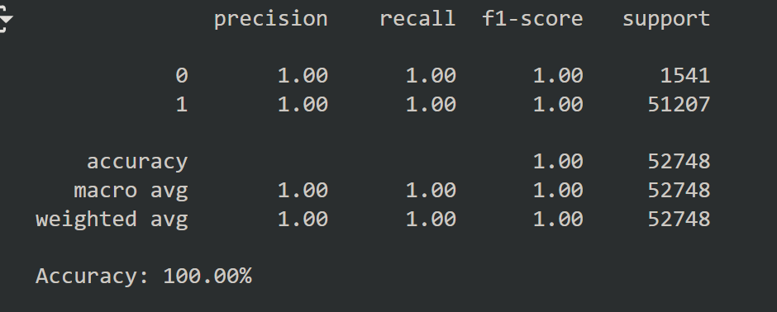
Interpretation of Results:
Perfect Scores:
Precision, Recall, and F1-Score: All being 1.00 (or 100%) for both classes (0 and 1) suggests that the model is perfectly classifying every instance.
Accuracy: An accuracy of 100% typically indicates that the model is correctly predicting all instances.

Slide 60
Interpretation of results
Make_Proportion (62.32%):
Significance: This is the most influential feature in the model, with a contribution of 62.32%. It suggests that the proportion of vehicles from a particular manufacturer within a region plays a crucial role in determining whether the region has high or low EV adoption.
Implication: This could imply that regions dominated by certain manufacturers are more likely to have higher EV adoption rates, possibly due to better brand recognition, marketing, or manufacturer-specific incentives.
CAFV Eligibility (24.44%):
Significance: The second most important feature, with a 24.44% contribution. This shows that whether a vehicle is eligible for Clean Alternative Fuel Vehicle (CAFV) incentives significantly influences EV adoption.
Implication: Incentives play a crucial role in driving EV adoption, particularly in regions where these incentives are available and utilized.

Slide 61
Interpretation of results
Dominant_Manufacturer_Proportion (8.99%):
Significance: This feature contributes 8.99% to the model, indicating that the proportion of the dominant manufacturer in a region is somewhat important but not as critical as the other factors.
Implication: While the dominance of a particular manufacturer matters, it’s less significant compared to the overall make proportion and incentive eligibility.
Urban (4.25%):
Significance: The least influential feature in the model, contributing 4.25%. This suggests that whether a region is urban or not has the least impact on EV adoption, according to the model.
Implication: Urbanization plays a role but is relatively less important compared to manufacturer influence and CAFV eligibility. However, it might still be an important factor in combination with others.

Slide 62
Key Findings
King County is clearly leading in EV adoption with 103,000 registered electric vehicles. This significant lead suggests that King County has been more effective in either implementing policies, infrastructure, or creating awareness that promotes EV adoption.
Besides King County, other urban counties like Snohomish (24,000 EVs) and Pierce (16,000 EVs) are also leading in EV adoption. This trend underlines the fact that urban areas have better infrastructure, incentives, and public awareness that contribute to higher adoption rates.
Rural areas, as observed, have much lower adoption rates, reflecting a possible lack of infrastructure and awareness.
In cities, Seattle has the highest number of EVs with 33,000 registrations, followed by Bellevue and Redmond, each contributing significantly to the overall urban EV adoption.
This finding indicates that cities with higher population densities and better economic conditions are more inclined toward adopting electric vehicles.
The data shows that urban regions overwhelmingly prefer BEVs over PHEVs. This preference could be attributed to the availability of more charging infrastructure, higher environmental awareness, and the greater range of BEV models available in these areas.

Slide 63
Key Findings
Urban consumers may also have higher disposable incomes, making them more likely to choose the newer, more expensive BEV models.
The trend analysis reveals that EV adoption has surged dramatically since 2015. This growth coincides with broader market trends, including the availability of more EV models, decreasing battery costs, and increasing environmental awareness.
The increase in EV registrations suggests that the market is maturing rapidly, and this trend is likely to continue as more consumers shift from traditional internal combustion engine vehicles to EVs.
BEVs account for 78.46% of the total electric vehicles, far outstripping Plug-in Hybrid Electric Vehicles (PHEVs), which only make up 21.54%.
This indicates a strong consumer preference for fully electric vehicles, possibly due to advancements in battery technology, the availability of longer-range models, and the growing number of charging stations.
This trend also suggests that BEVs are viewed as a more future-proof choice compared to PHEVs, which may be seen as a transitional technology.
Tesla leads the market with 88,000 EVs, significantly ahead of other manufacturers like Chevrolet (15,000 EVs) and Nissan (14,000 EVs). This is indicative of Tesla's strong brand recognition, superior technology, and early entry into the market.
The data also suggests that Tesla's strategy of creating a high-quality network of superchargers and a robust brand ecosystem has paid off in terms of customer loyalty and market share.

Slide 64
Actionable Recommendations
The low adoption rates in rural counties highlight a significant opportunity for growth. Expanding the charging infrastructure in these areas is essential to bridge the adoption gap and encourage rural consumers to consider EVs as a viable option.
Rural and low-adoption areas could benefit significantly from targeted incentives such as tax rebates, subsidies, or reduced registration fees for EVs. These incentives should be designed to address the unique challenges faced by consumers in these regions.
The overwhelming preference for BEVs, efforts should focus on supporting their growth through increased investment in charging infrastructure, particularly fast chargers.
Marketing campaigns should highlight the benefits of BEVs over PHEVs, such as lower long-term costs and environmental impact.
The dominance of Tesla suggests that there is a strong market preference for certain brands. Collaborating with these manufacturers to offer exclusive deals or incentives could further boost adoption.

Slide 65
Actionable Recommendations
Additionally, introducing other leading global EV brands could enhance competition and offer consumers more choices, potentially driving down prices.
The exponential growth in EV adoption observed after 2015 suggests that this is a rapidly evolving market. Continuous monitoring of emerging trends, including new EV models, battery technology, and consumer preferences, will be crucial for maintaining relevance in this fast-growing sector.
Stakeholders should be prepared to adapt their strategies in response to changes in the market to continue promoting the adoption of EVs effectively.

Slide 66
Questions & Answers

Slide 67
Thank You

